Slide 1

My Data Interactive Notebook
Name
Class
Teacher
Semester 2
Term 3
1

Slide 2

Interactive Notebooks!
Cover Page
Contents Page
Glossary
24/7/30
EQ
Questions
Notes
Summaries
Work page
Presentation!!!
Your book, your responsibility!

Slide 3
Contents
Glossary or Formula Page
Page
Date
Description
2
3

Slide 4
Tasks
24
7
30
Essential Question
Questions
Notes
Summary

Slide 5
Let’s get writing!
What words do you associate with data? Do a quickwrite for 2 mins and see what you can come up with.

Slide 6
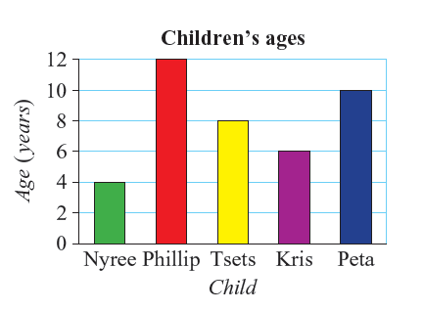
24
7
30
Date
Topic: Data
EQ – What are the different types of data?
Insert question here
Data is facts and statistics used for reference or analysis. Large amounts of data can be used to help us understand the world and predict the future. Data is displayed using graphs and tables so it is easy to see patterns.
Insert question here
Categorical data: Described using words (Eg type of pet)
Numerical data: Expressed as numbers (Eg number of pets)
Discrete data: Not ordered, only whole numbers (Eg rolling a dice)
Continuous data: Ordered, includes decimals (Eg height)
Be careful of categorical data that uses numbers!

Slide 7
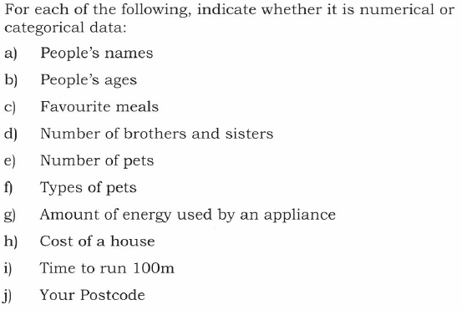
Categorical or Numerical?

Slide 8
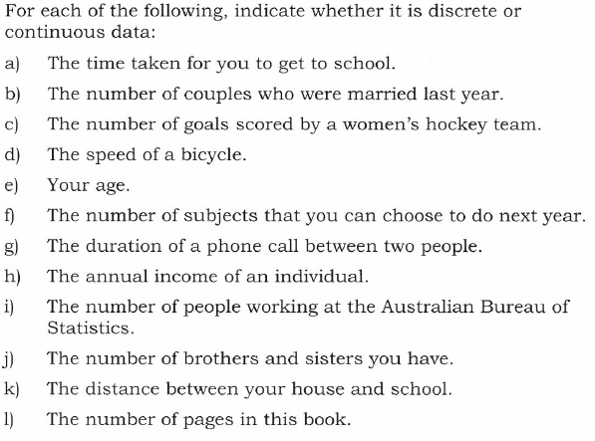
Discrete or Continuous?
What type of graph should you use for each of the types?

Slide 9
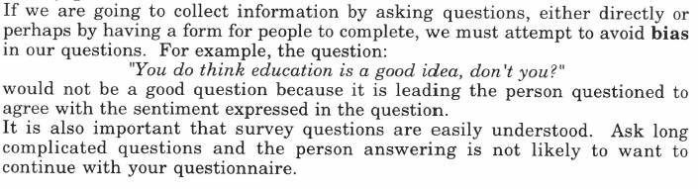
24
7
30
Date
Topic: Data
EQ – What are the potential issues when collecting data?
Insert question here
Collecting data can be prone to bias. Bias is when something is unfair because of particular reason.
Have you come across bias before? Do a quick write for the word bias.
You do not need to copy paragraph below!
Insert question here
Some reasons for bias
Group: Survey Question
People who choose to be involved - Limited or poor options
Only people who are available - Leading questions
Age - Confusing
Gender - Offering reward for particular response

Slide 10
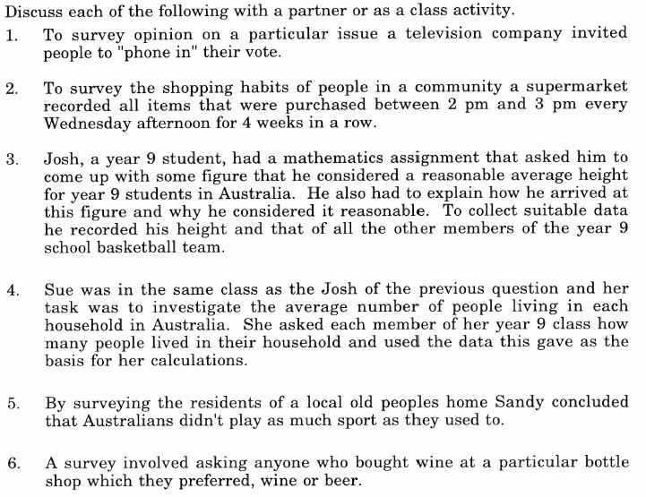
and decide what makes it biased.

Slide 11
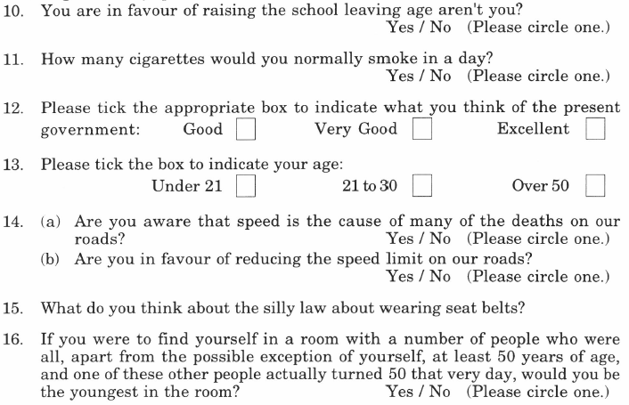

Slide 12
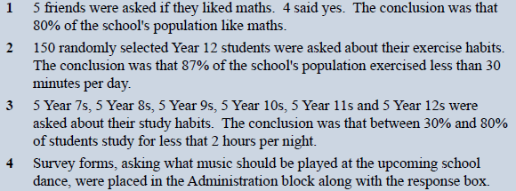
Now you have a go!
Turn to page 178 in the Dwyer book (or see below)

Slide 13
24
7
30
Date
Topic: Data
EQ – What are the different ways of collecting data for large groups?
Insert question here
In a census (or population survey), everyone in a population is surveyed.
In a sample, a section of the population is surveyed.
A census is more accurate but samples are quicker and cheaper.
There are three types of samples that can be used.
1) Random: Random groups
Everyone is randomly chosen.
2) Stratified: Proportional Groups
In stratified, people are organised into groups and a proportionate number of each group is sampled. Eg if there is 30 male teachers and 70 female teachers the a sample of 10 teachers should have 3 males and 7 females.
3) Systematic: Systematic Groups
When people surveyed are chosen using a system.
Eg – When arranged in a sequence, every 20th person from a list is surveyed.
Insert question here

Slide 14
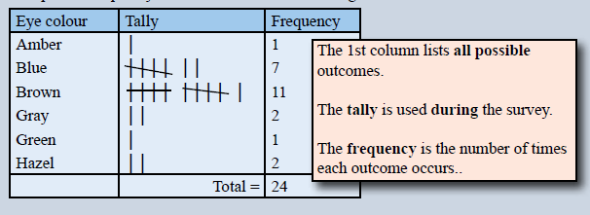
Time to collect some data!
Have a go at writing your own survey question to ask the rest of the class.
A good way to collect data is using a frequency table
Was your survey question biased? What about your sample group?

